Slide 1
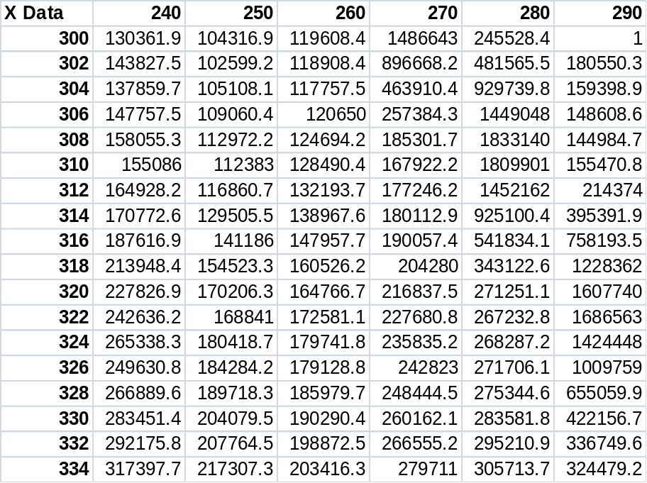
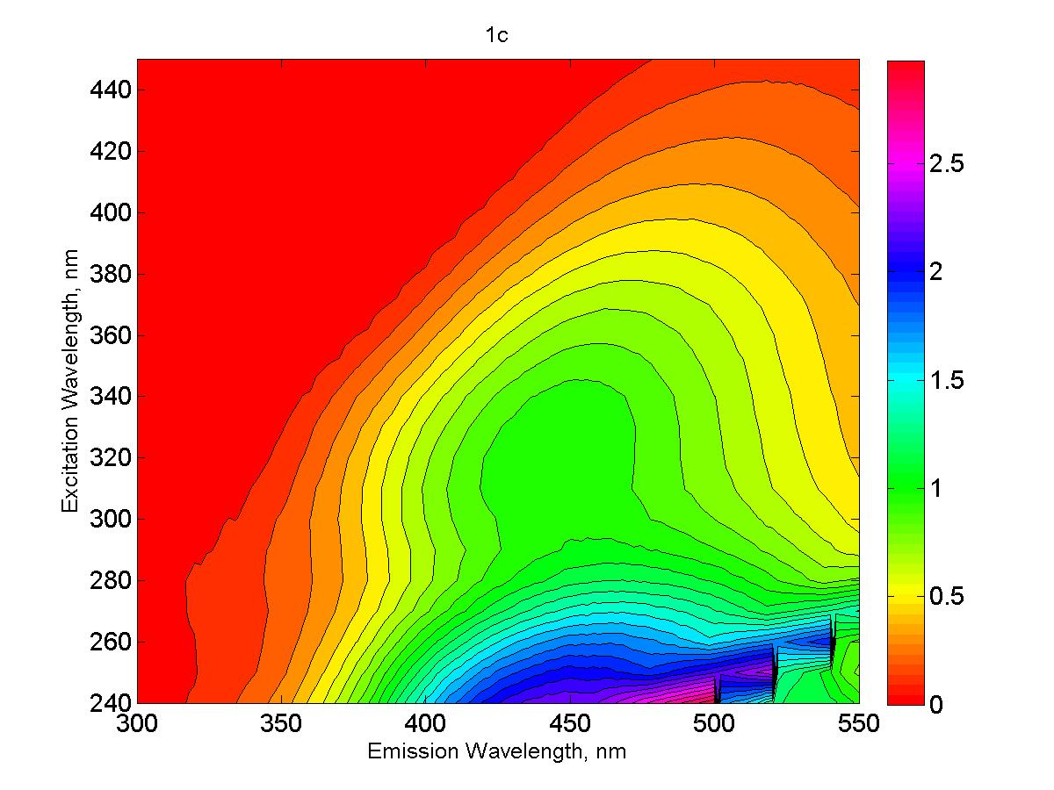
Correcting and Modelling EEMs

Slide 2
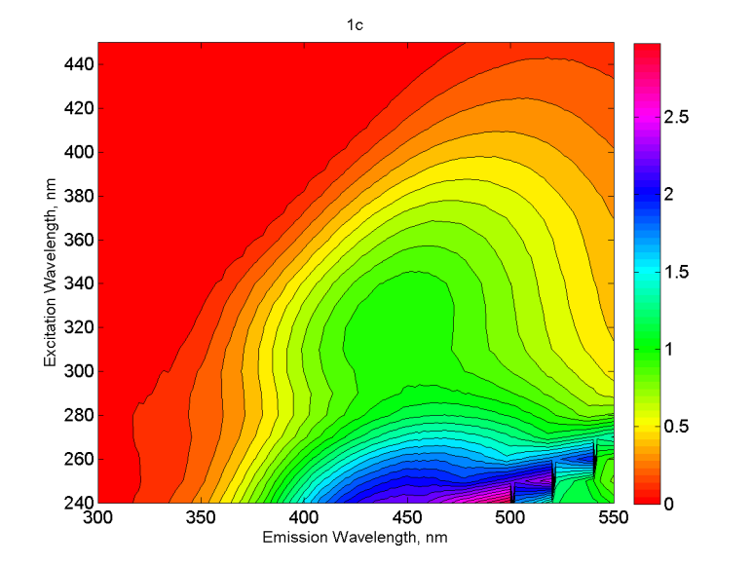
What you need to get this:
UV-VIS Scan
Instrument Correction files (somewhere)
Water Ramn
Blank
Raw EEM
And the code!

Slide 3
Two General Steps
Generate Corrected EEMs
  Use- CorrectFunII & RunCorrectionsII
Fit Cory & McKnight model to EEMs
  Use- DataInAndModel
We will walk you through it

Slide 4
Correction Methods
Recommended Method:
Instrument Correct the Raman file
Instrument Correct and Raman Normalize the Blank
Instrument Correct the Sample
Inner filter Correct the Sample
Raman Normalize the Sample
Blank Subtract

Slide 5
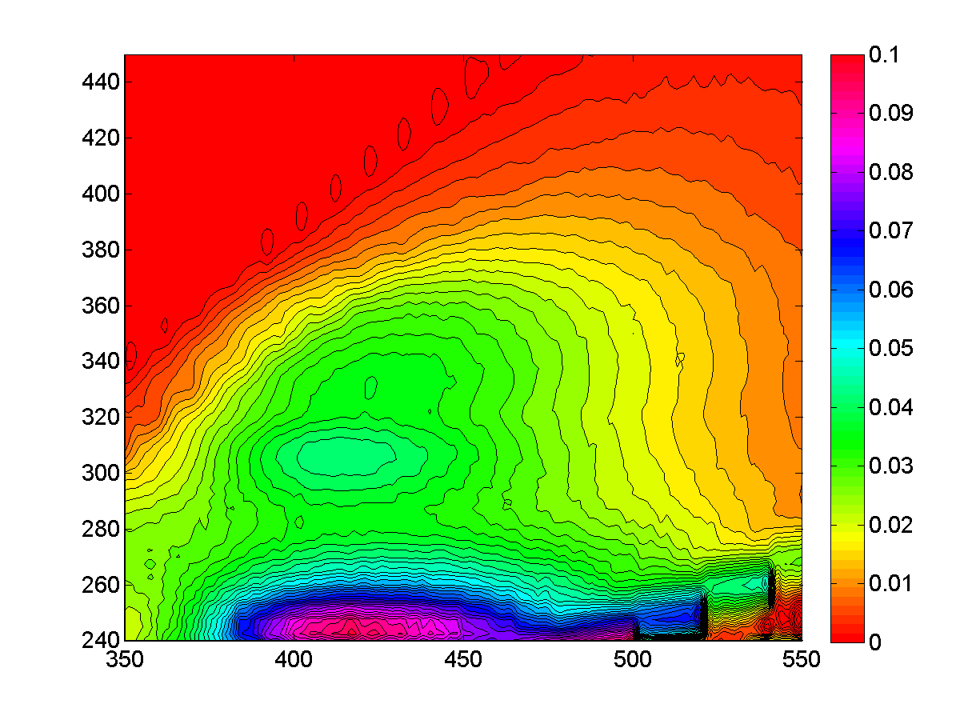
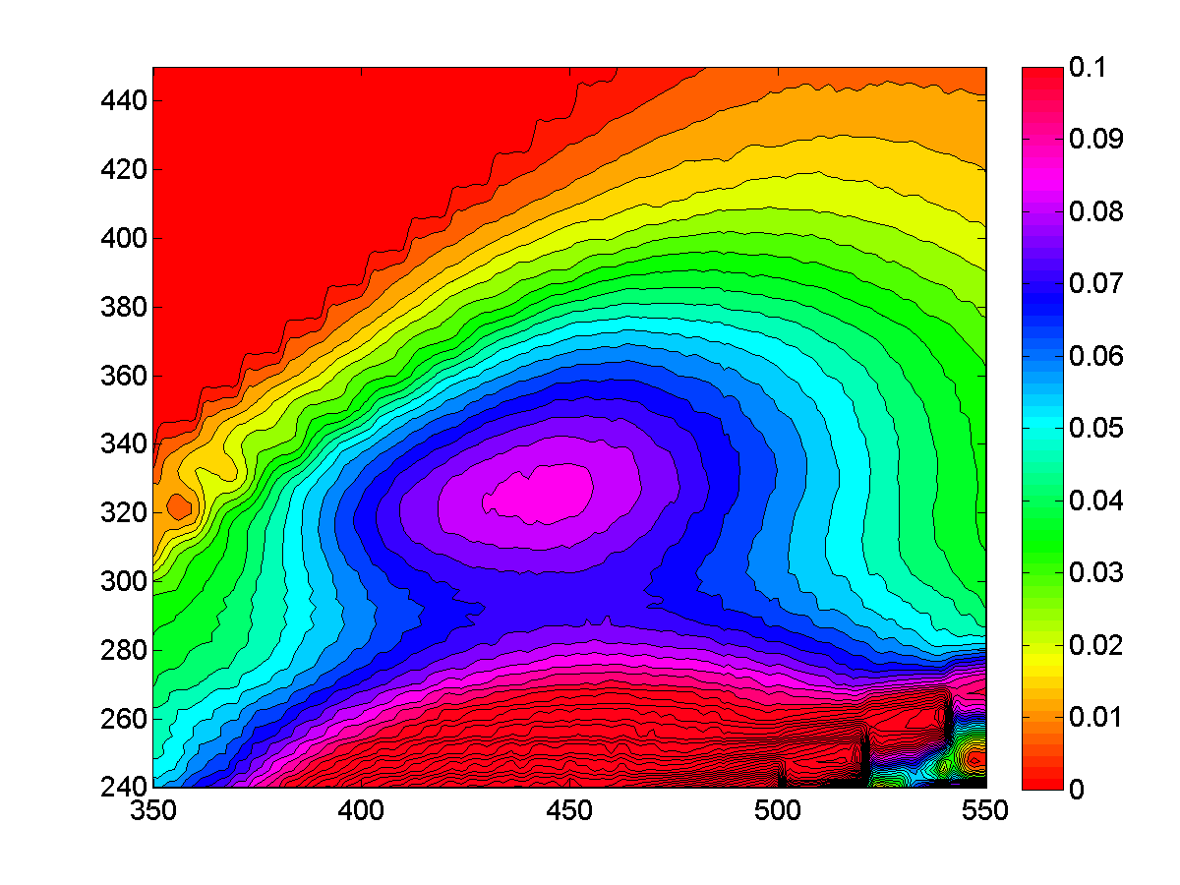
Measuring Source and Quality of DOM –
3D Fluorescence
Oxidized
Reduced
Excitation (nm)
Emission (nm)
Protein Peaks
Humic Peaks
Notes:
Peak locations (410 vs. 445)

Slide 6
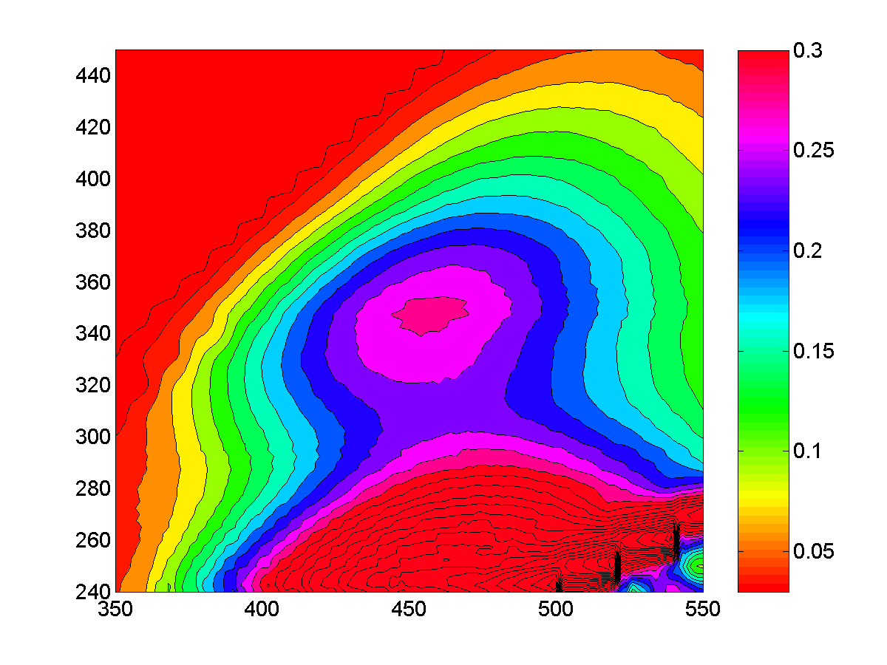
DOM Characterization-Modeling
DOM Fluorescence: Proteins and Humic Substances
PARAFAC Modeling:
Excitation (nm)
Emission (nm)
Excitation-Emission Matrix
(EEM)
Comp. 1 Comp. 2 Comp. 3

Slide 7
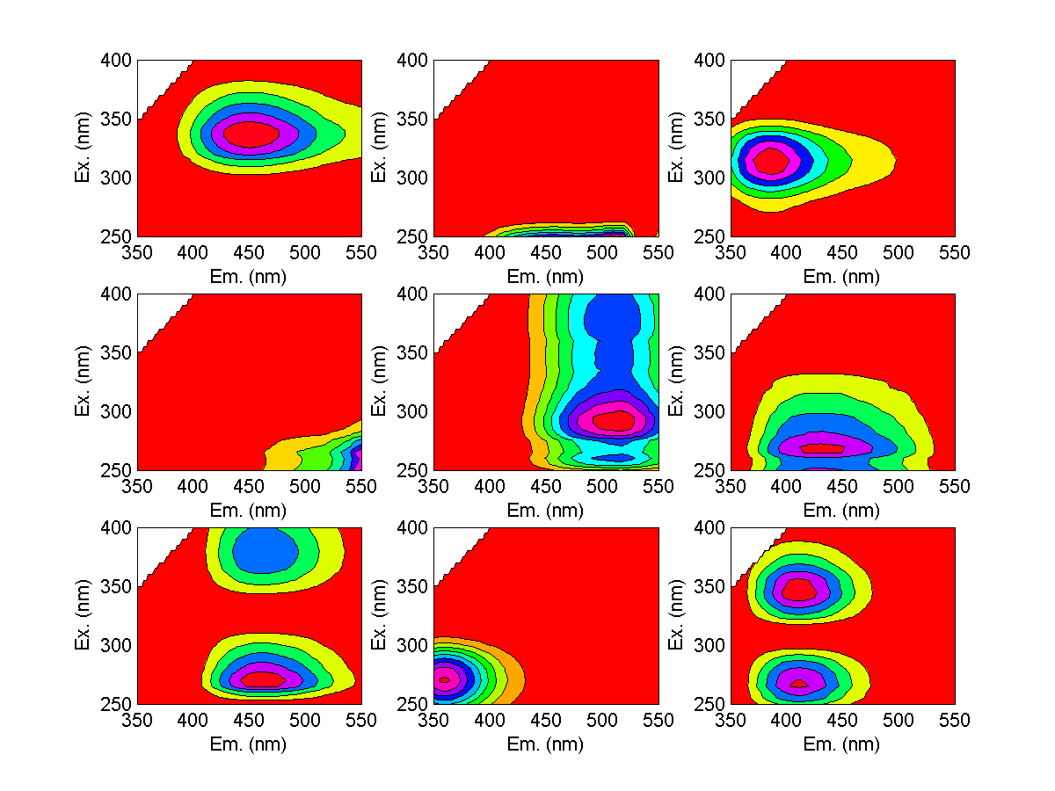
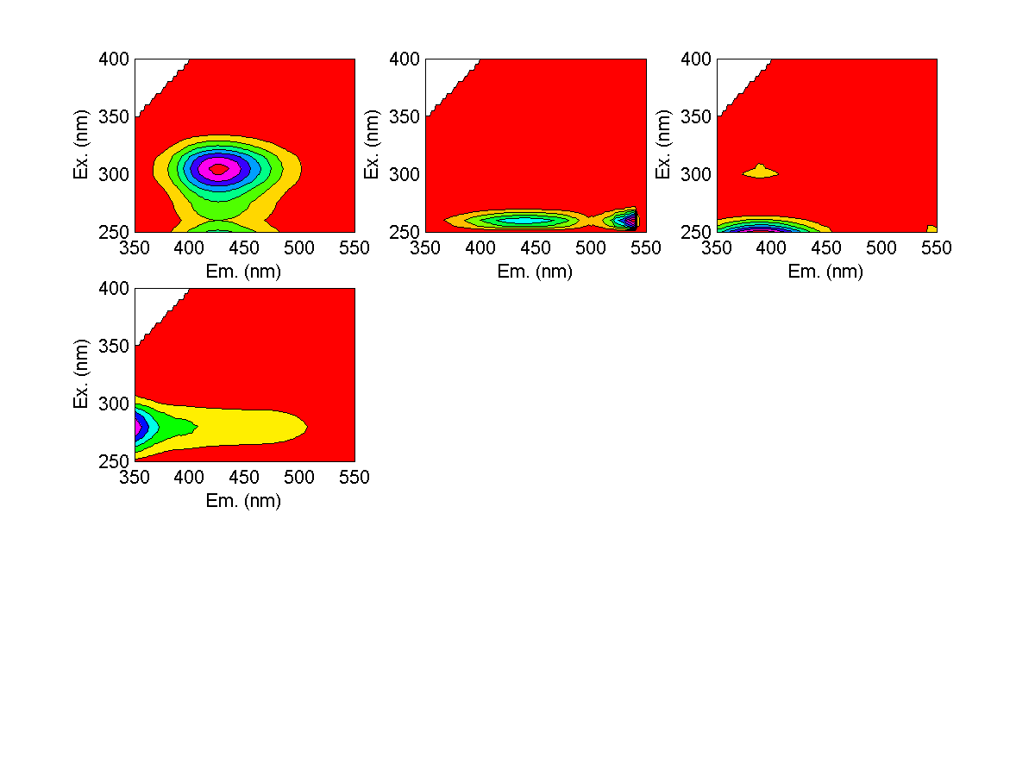
C1
C2
C3
Each PARAFAC
component represents a
unique fluorophore
C4
C5
C6
C7
C8
C9
C10
C11
C12
C13

Slide 8
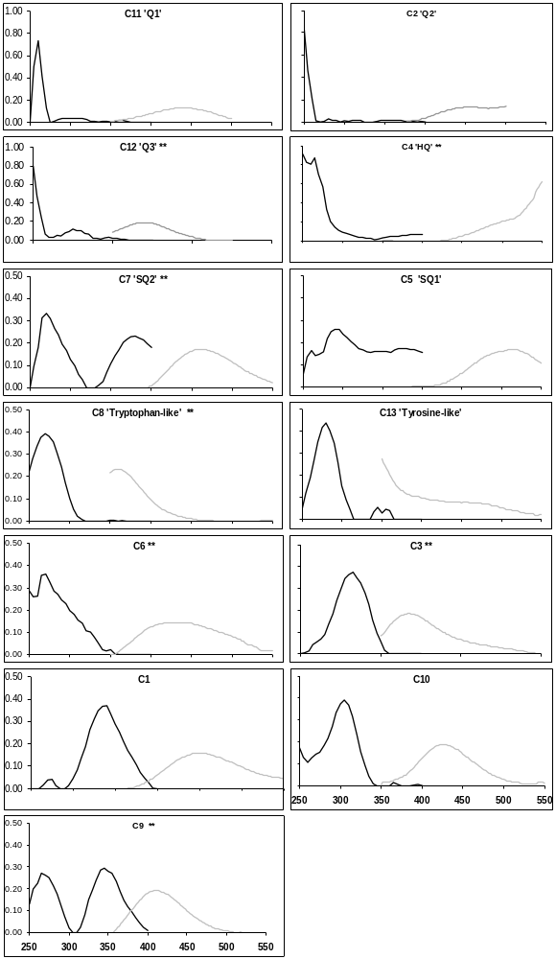
PARAFAC yields
Components of DOM
Total= 13
Quinones= 6
Tyrosine and Tryptophan= 2
Ex and Em spectra reveal chemistry

Slide 9
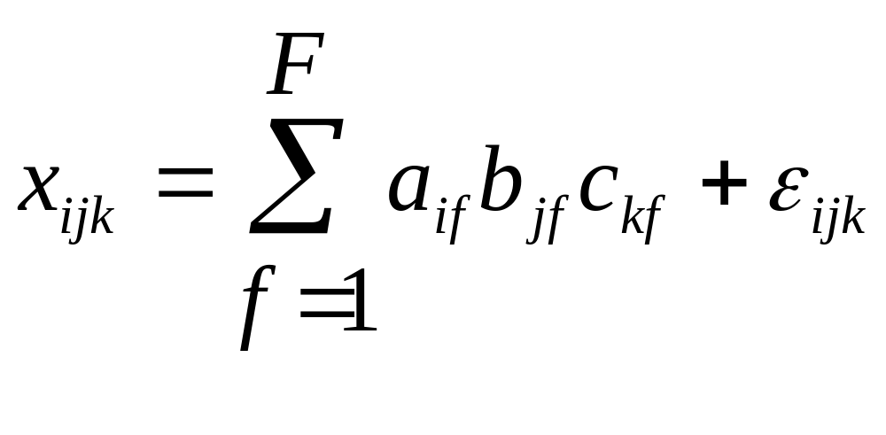
How Does PARAFAC work?
F = number of components
X_{ijk} = intensity of fluorescence for the ith sample et em λ j and ex λ k (e.g. modeled EEM)
a = loading or “concentration” of fluorophore (f)
b = quantum yield at em λ j (ratio of light emitted:light absorbed)…..for ideal fluorophore = 1
c = (molar absorbtivity) at excitation λ k….efficiency with which light is absorbed
ε = residual matrix; variability not accounted for by model
Model found by minimizing sum of squared residuals

Slide 10
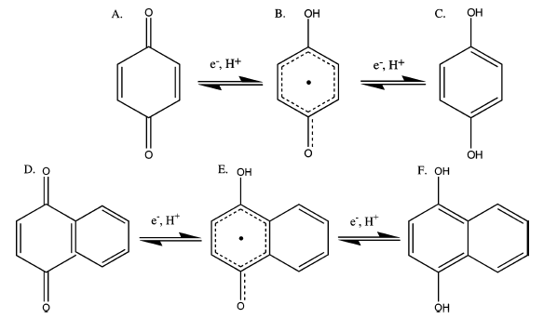
DOM Characterization
Cory and McKnight (2005): 13 component model
*7 Quinone Like Components (4 reduced and 3 oxidized)
Benzoquinone (microbial)
Napthoquinone (terrestrial)
Ox.
Quinone
Semi-
Quinone
Red.
Quinone

Slide 11
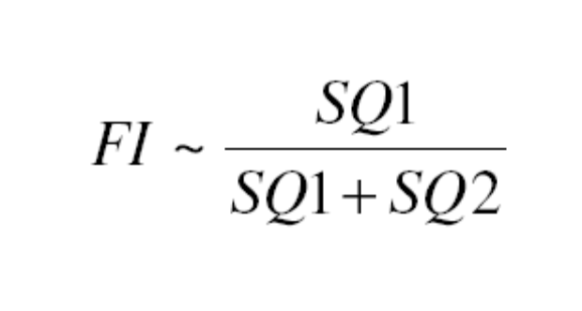
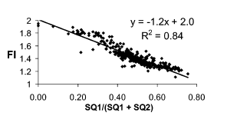
DOM Characterization-Source
SQ2 (microbial origin)
SQ1 (higher plant origin)
Cory and McKnight (2005)
Notes:
Quinones can come from extracellular release by microbes – quinone-like moieties.

Slide 12
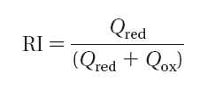
DOM Characterization-Redox
Q_{ox} = Σ Q1, Q2*, Q3*
Q_{red} = Σ SQ1, SQ2*, SQ3*, HQ*
*Microbial Origin
Miller et al. (2006)

Slide 13
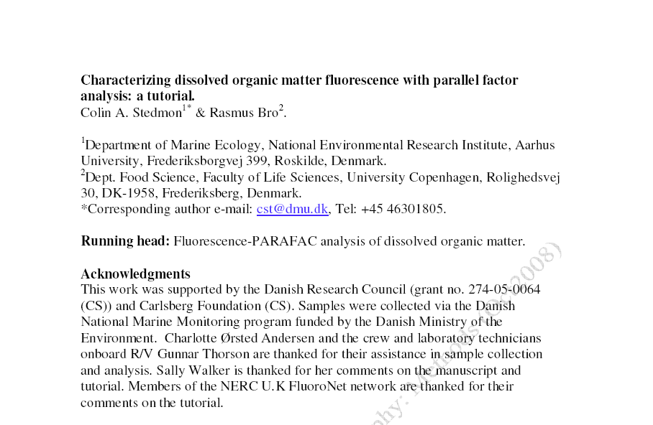
Build Your Own Model
http://sites.google.com/site/colinstedmon/domfluortoolbox

